Slide 1
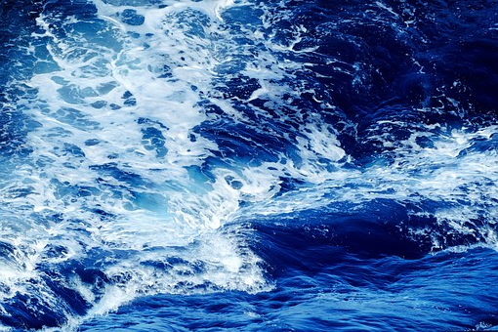
P108-Knowledge sharing on Trade and investment “Good Practices II
“
Cluster 4: Quality Infrastructure and Standards
:
Brusssels 4th February 2020
Quality assessment and standards conformity for fisheries and aquaculture, and enhanced export capacity
Subject

Slide 2
MOZAMBIQUE BACKGROUND
General geographic and economic indicadors
Fisheries segment and aquaculture
INSTITTUCIONAL FRAMWORK OF COMPENTENT AUTHORITY
FISH AND AQUACULT QUALITY ASSESSMENT AND STAND. CONFORMITY .
Governing legislation
International stands for EU
Laboratories and acreditation process
Fish Inspection Process
TRADE FACILITATION FOR FISH AND AQUACULTURE PRODUCTS EXPORT
Electronic single window
Tecnhical assistance
Challenges
BOTLENECKS AND CONSTRAINTS CNTROL SYSTEM
WAYS FORWARD
TOPICS

Slide 3
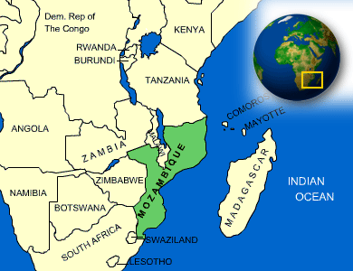
1. MOZAMBIQUE
BACK-GROUND
Mozambique is situated on the southwest coast of Africa, bathed by the Indian Ocean

Slide 4
1.1 General geographic and economic Indicators
Country area | 799 380km²
Land area | 786 380km²
Inland water area | 13 000km²
Population - Est. & Proj. | 28.554millions
Exclusive Economic Zone (EEZ) area | 567 883km^{2 FF}
Fisheires sector contribution GDP | 3-4%
Abundant marine and fresh water fishery resources

Slide 5
1.2 Fisheires segments and Aquaculture
Artisanal fisheries, is the most important sector by volume and contribution to the economy which provide income to about 280,000 people, contribute to 90 per cent of marine captures and account for 42 per cent of total value.;
Semi-industrial fishing comprises mainly small trawlers involved in domestic coastal shrimp fisheries and accounts for 2 per cent of annual marine catches and 6 per cent of total value . Produce is either sold in local markets or exported
Industrial fishing includes large vessels flagged in Mozambique and other countries, mostly targeting crustaceans – coastal shrimp and deep-sea shrimp – usually processed at sea and for export, mainly to Japan and Europe

Slide 6
Aquaculture
Aquaculture development and opportunities Mozambique possesses great untapped aquaculture potential, with a favourable environment, including climatic conditions – tropical temperatures allowing for year-round production –Suitable land for coastal aquaculture and wild native species that can be farmed.
However, the growth of the sector is constrained, mainly by infrastructure
The cultured species include fish, crustaceans and aquatic macro algae. The species most cultivated are the native marine prawn species: giant tiger prawn (Peneaus monodon ), Indian white prawn (Peneaus indicus ) and the native freshwater fish Mozambique tilapia (Oreochromis mossambicus

Slide 7
2. INSTITUTIONAL FRAMEWORK OF THE COMPETENT AUTHORITY
The Ministry of Sea Inland Water and Fisheires (MIMAIP) was created in 2015 to manage the sustainable use of the sea and inland waters, including fishing exploitation, the ecosystem, waste and pollution management, research, as well as their respective regulations, planning, licensing and inspection.
National Institute for Fish Inspection (INIP) IS the CA, with mandate to ensure management of the sanitary quality of water source food products, throughout the supply chain, to the market.

Slide 8
The Competent Authority has the following duties:
Propose definition of policies, strategies and plans with regard to quality health care of fishery products;
Propose approval of regulatory principles and establish technical standards of inspections to aquatic products and laboratories;
Promote and support institutional forms of community involvement in the quality assurance systems of aquatic origin food and the value chain of fish production;
Promote monitoring and certification of the health of aquatic organisms in coordination with the competent veterinary authority

Slide 9
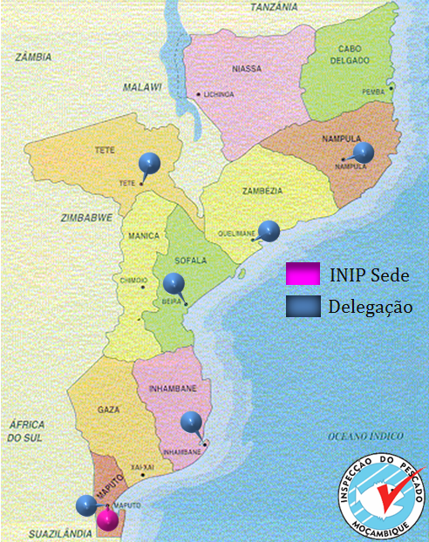
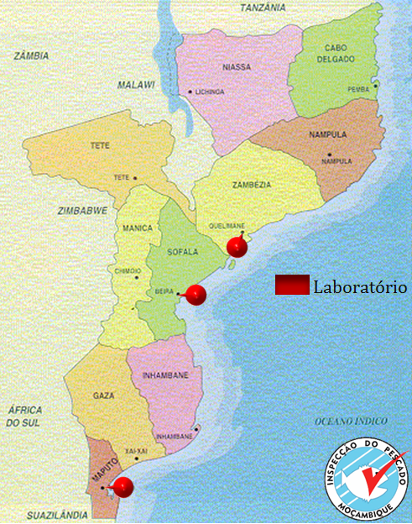
INIP currently operates with 149 employees., 6 provincial delegations and 3 representations. 3 Fish Inspection Labs (LIPs)

Slide 10
3. Quality assessment and standards conformity for fisheries and aquaculture products
In order to comply with these requirements effort have been made for:
3.1 The governing regulations
The Fisheries Law (Law 22/2013 of 1st November 20213) and subsequent regulations form the legal basis for the fisheries sector.
The Fisheries Law defines the role and responsibility of the fisheries administration and the principles which guide the fishing activities.

Slide 11
The general regulation for hygiene control of foodstuffs of aquatic origin which guide the fquality control activities.
General aquaculture regulation that defines all rights and obligations of all stakeholders in Mozambique (Decree 35/2001 of 13 of November). The legislation defines specific norms and requirements for aquaculture farms and establishes procedures for licensing and parameters for each farming system

Slide 12
3,2 International standards compliance for European Union exports
In 2013, an audit by the Food and Veterinary Office of the EC evaluated whether production conditions of fishery products for export complied with the requirements in European Union legislation.
The audit noted that legislation and standards with regard to fish exports were in accordance with EU provisions, provided that the CA continued to implement an official control system in order to ensure conformity with EU requirements.
The audit determined that the CA had an adequate structure and organization to perform official controls, including the implementation of sanitary requirements for handling, processing and distributing fishery products through licensing and inspection, health certification and laboratory analysis.

Slide 13
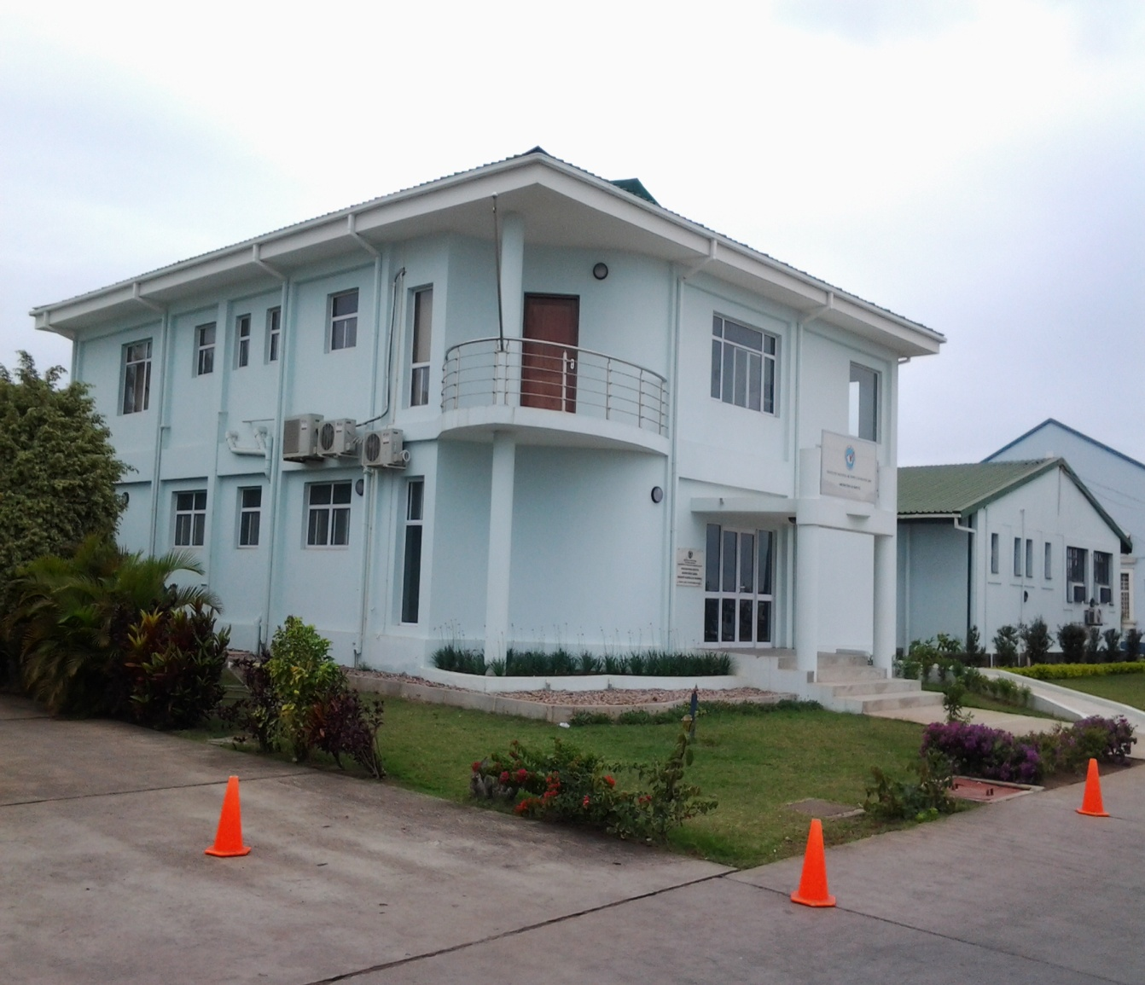
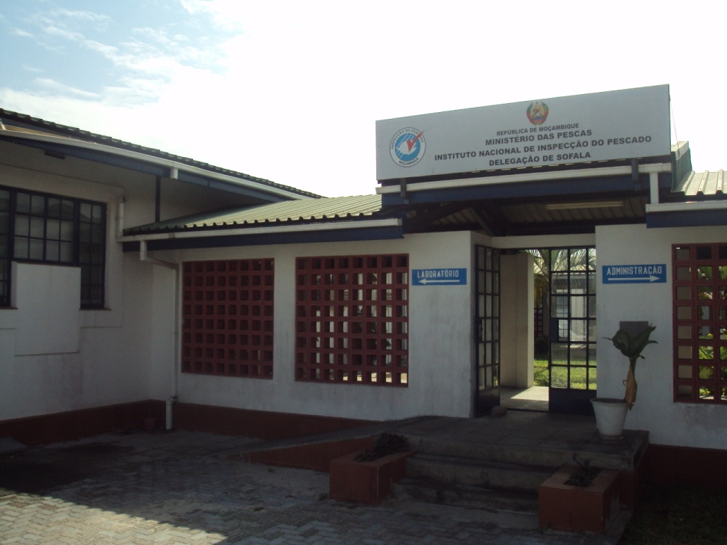
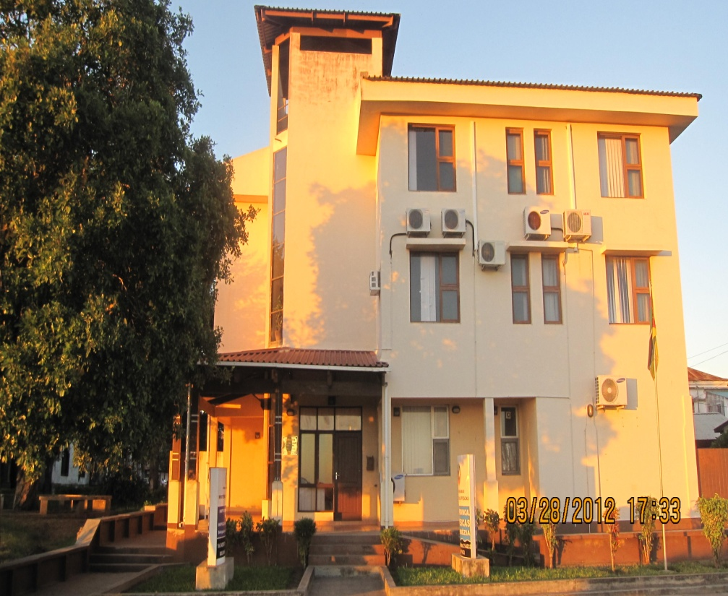
3.3 Laboratories
As a result of the support received through the DANIDA, DFID and ICEIDA -financed programmes, INIP has been able to install and upgrade its 3 laboratories to better track export certificates, and train the industry on food safety principles.
LIP Maputo
LIP Beira
LIP Quelimane

Slide 14
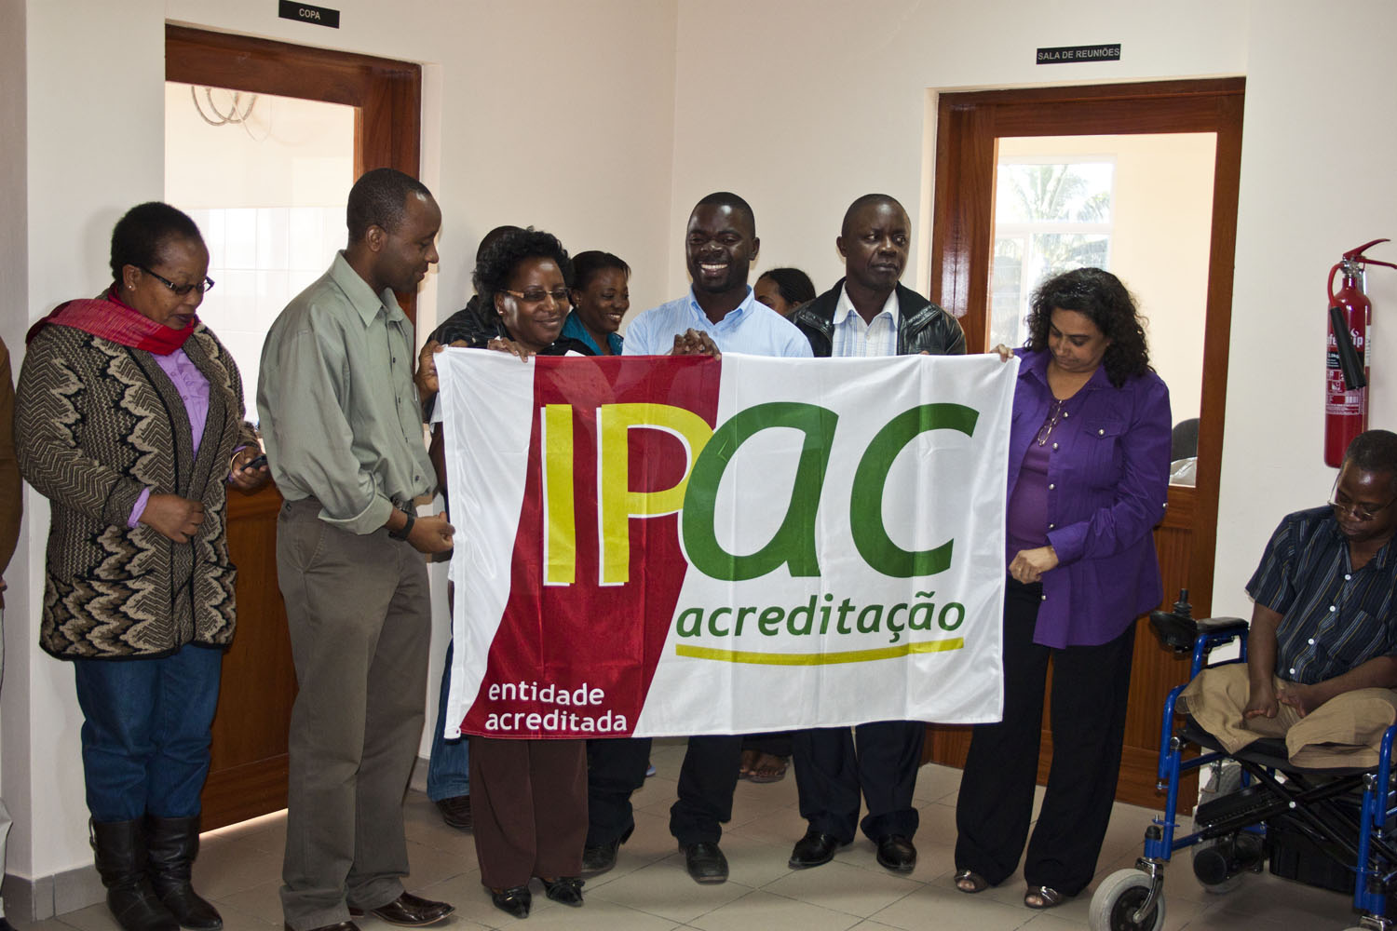
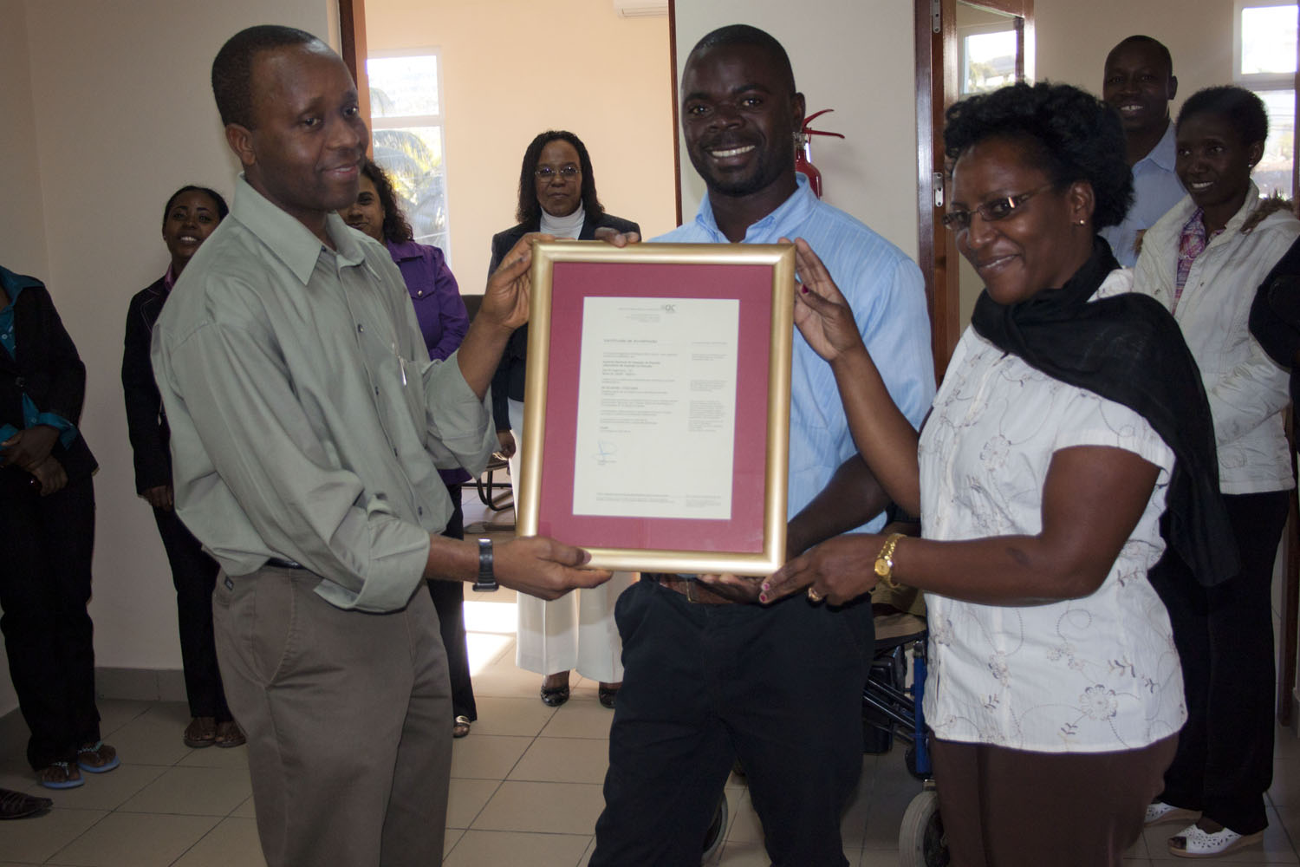
3.4 Accreditation Process
The 3 Laboratories are acredited in accordance with ISO17025:2005

Slide 15
Since 2019 the Inspecpetion system is in priocess of accreditation according ISO 17020
Organoleptic, chemical and microbiological analyses are performed in all 3 Laboratoris.
For those analyses which are not performed in Mozambique are send in accredited or reference laboratories namely South Africa, Portugal and Spain
Fisheries diagnostic disease are send to United States, and Thailand Laboratories

Slide 16
3. 5 Fish Inspection Process
The competent Authority frequently inspect the fish processing plants and evaluate the processing units in respect of minimum sanitary and hygienic facilities required for good manufacturing practices.
Apart from inspection, the inspector collects representative samples at random for microbiological and chemical analysis in the laboratory.
The export-worthiness of the product is judged on the basis of in-plant inspection and laboratory analysis reports.
To obtain a pre-shipment salubrity certificate for any product, both the inspection and laboratory reports should conform to the standard specifications stipulated by the Competen Authprity for the particular product.

Slide 17
4. TRADE FACILITATION FOR FISH AND AQUACULTURE EXPORT
The Mozambique is committed to coordinating, supervising and monitoring the implementation of the Trade Facilitation Agreement in the country. Thus efforts have been developed to enhance fish and aquaculture prouction and export diversification :
National Committe for trade facilitation- aims to simplify commercial procedures, close to good international practices, with emphasis on inspection;
Electronic single window-aimed to facilitate international trade and business enironment with innovative solutions designed to facilitate international trade.

Slide 18
The bilateral and multilateral cooperation in fisheries have included institutional support within areas where the countries and NGO offer knowledge through Technical Assistance and insights with specific relevance for the Mozambican side.
However there is still a need for capacity building in fisheries management, biosgurity and quality assessment for value added products.

Slide 19
Excessive fishing effort and the use of destructive fishing techniques contribute to reduced catches and to the degradation of ecosystems
Challenges
Fishing communities are often small, isolated and poor. Although
artisanal fishermen produce 85% of the annual catch.
The business environment remains inadequate, with low private sector engagement with the capacity to finance sustainable fisheries and
aquaculture
These challenges face the constant risk of climate change, which, associated with poor coastal management and low resilience, continues to cause loss of habitat and degradation of ecosystems, compromising the natural capital, the livelihoods of thousands of people. and the health and wealth of the entire country

Slide 20
5. BOTTLENECKS AND CONSTRAINTS IN QUALITY CONTROL SYSTEM
Institutional - Not Sufficient number of fish inspectors and technologists which retards Fish and aquaculture quality control activity.
Lack of computerized database, system of checking, data analysis and methodology development in the national quality assurance program.
Plant management : Lack of commitment by the top management hinders quality control, which is directly proportional to the importance placed on it by top management.
Lack of proper knowledge of modem sanitation techniques in controlling plants.

Slide 21
6. IMPROVEMENTS NEEDED
INSTITUTIONAL- Over all implementation of electronic single winddow
Organizational facilities: Existing Q.C. laboratories need to be equipped with adequate modem equipment, machinery, chemicals and computerized facilities.
Smallscale Q.C. and inspection satellite stations are needed at each at the major fish and shrimp landing and processing provinces Laboratory equipment and facilities must be improved to ensure effective analysis of fish and fish products for pathogens, toxic elements, pesticidal residue, and antibiotics .

Slide 22
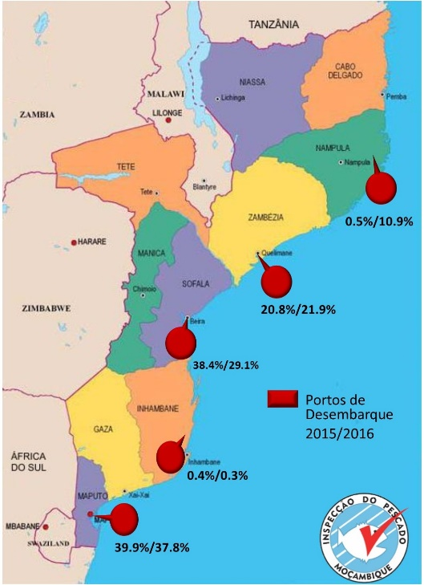
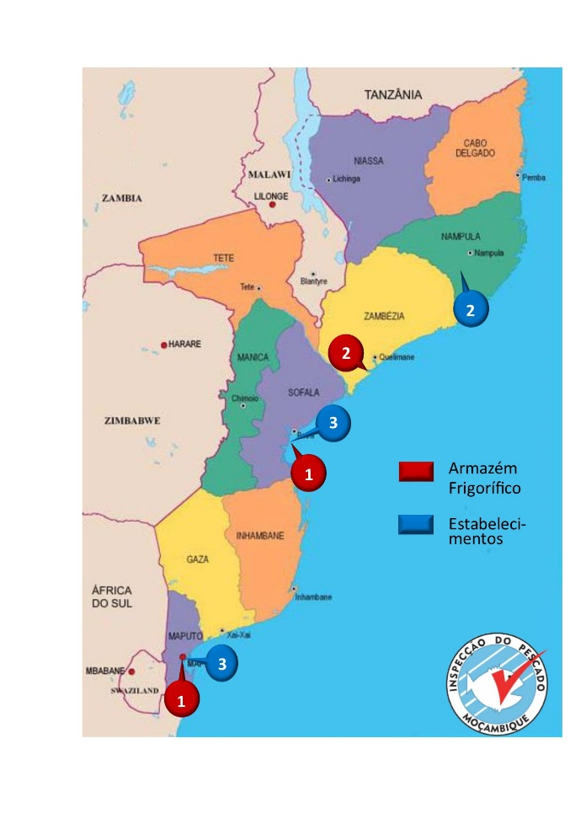
Infrastructure : Modern hygienic fishing ports and fish landing centres are needed on a priority basis. Proper utilization of the existing modem fish landing centres to ensure primary quality of fish and fish products.
Establishment of more ice-plants, cold-stores and preservation facilities.
Cold store
LANDING SITES

Slide 23
CONCLUSION
The fisheires sector need to make the National Competent Authority capable of giving official guarantees without restrictions to fishery products for the national market and their access in the regional and international markets

Slide 24
THANK YOU

